Slide 1
State
Factory
&
Design Patterns

Slide 2
Group 1
03
19
Đào Minh Đức
Lưu Hoàng Thúy Vân
Member
Member
03
19
09
27
09
27
Nguyễn Bảo Ngọc
Lê Nguyễn Hoàng Nghi
Member
Member

Slide 3
Table of contents
What is State design pattern?
1
7
Why would we want to use State pattern?
6
2
4
3
When should we use State pattern?
Implementation
5
4
3
Sample problem
5
2
Task delegation
1
6
Brigde design pattern
7

Slide 4
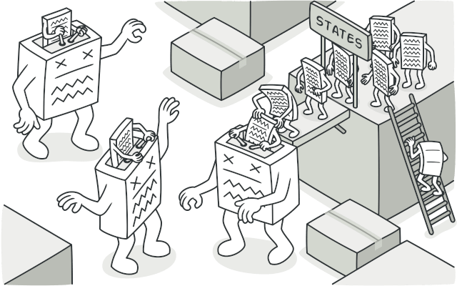
What is State Pattern?
State design pattern
01

Slide 5
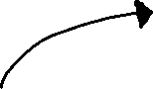


What is State Pattern?
01
Behavioral
design pattern
State design pattern
Allows an object alter its behavior when its internal state changes
Similar to the concept of
Finite -State machines

Slide 6
Why would we want to use State pattern?
Why would we want to use State design pattern?
Simplify the code of the context
Single Responsibility Principle
Open/Closed Principle
02
By eliminating bulky state machine conditions
Organize the code related to particular states into separate class
Introduce new states without changing existing state classes or the context

Slide 7
Why should we want to use State pattern?
Why would we want to use State design pattern?
02
Single Responsibility Principle
Open/Closed Principle
Simplify the code of the context
Organize the code related to particular states into separate class
Introduce new states without changing existing state classes or the context
By eliminating bulky state machine conditions
03
When should we use State pattern?

Slide 8
When should we use State pattern?
When should we use State design pattern?
Why should we want to use State design pattern?
Single Responsibility Principle
Open/Closed Principle
Simplify the code of the context
03
Organize the code related to particular states into separate class
Introduce new states without changing existing state classes or the context
By eliminating bulky state machine conditions

Slide 9

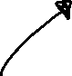
When should we use State pattern?
An object behaves differently depending on its current state
03
When should we use State design pattern?
A class polluted with massive conditions that alter how the class behaves
A lot of duplicate code across similar states and transitions of a condition – based state machine

Slide 10
Implementation
04

Slide 11
How to implement it at abstract level?
Declare the state interface
Add a reference field of the state interface type and public setter to the context class
Create an instance of one of the state classes
Decide what class will be the context
Replace empty state conditionals
Create a class derives from the state interface
Notes:
Step1: Decide what class will act as the context. It could be an existing class which already has the state-dependent code; or a new class, if the state-specific code is distributed across multiple classes.
Step 2: Declare the state interface. Although it may mirror all the methods declared in the context, aim only for those that may contain state-specific behavior.
Step 3: For every actual state, create a class that derives from the state interface. Then go over the methods of the context and extract all code related to that state into ur newly created class
Step 4: In the context class, add a reference field of the state interface type and a public setter that allows overriding the value of that field.
Step 5: Go over the method of the context again and replace empty state conditionals with calls to corresponding methods of the state object.
Step 6: To switch the state of the context, create an instance of one of the state classes and pass it to the context. You can do this within the context itself, or in various states, or in the client. Wherever this is done, the class becomes dependent on the concrete state class that it instantiates.

Slide 12

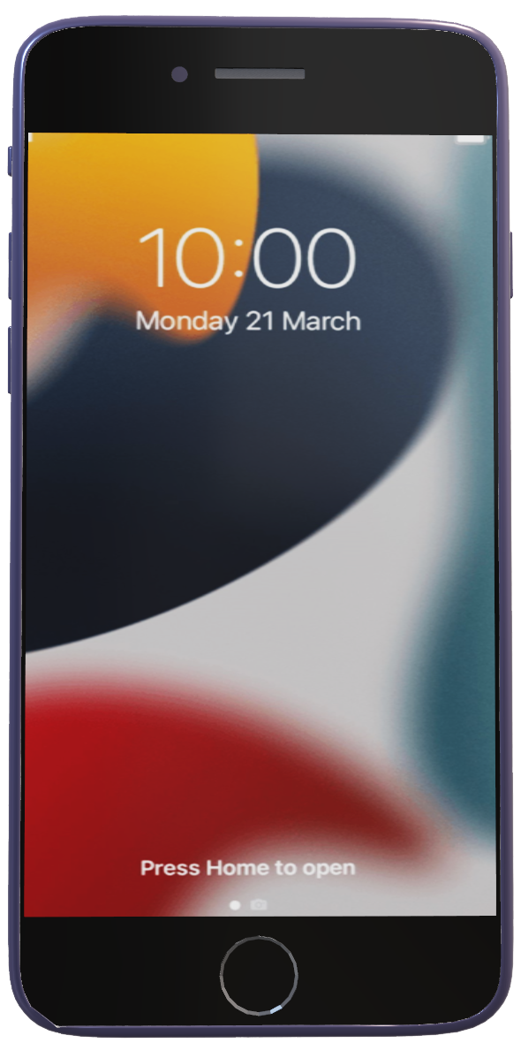
Sample problem
05
This is an
Iphone SE

Slide 13

Iphone SE
05
This is an
Sample problem

Slide 14



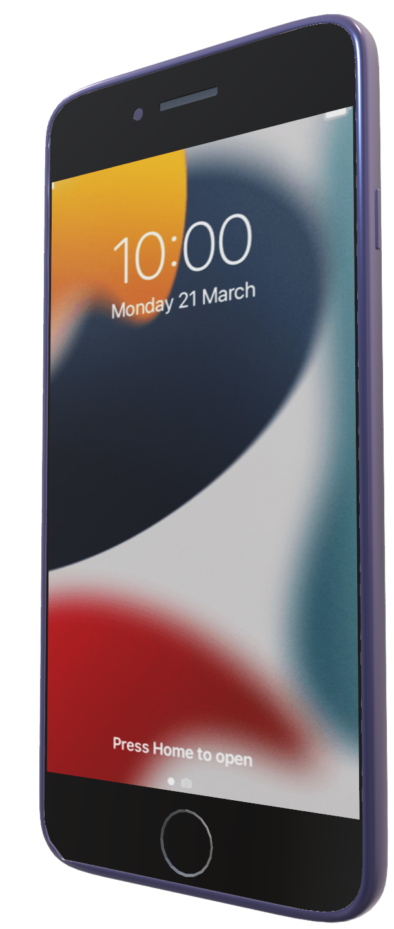
Iphone SE
This is an

Slide 15
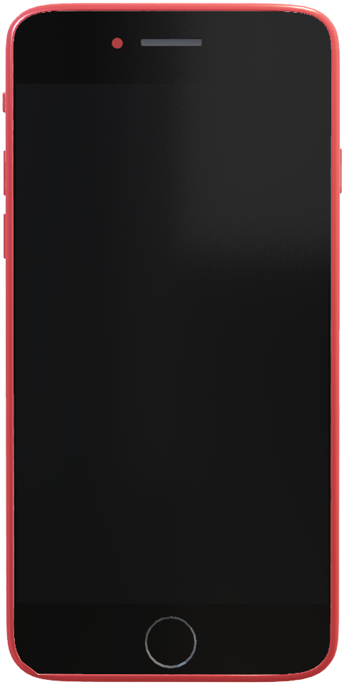
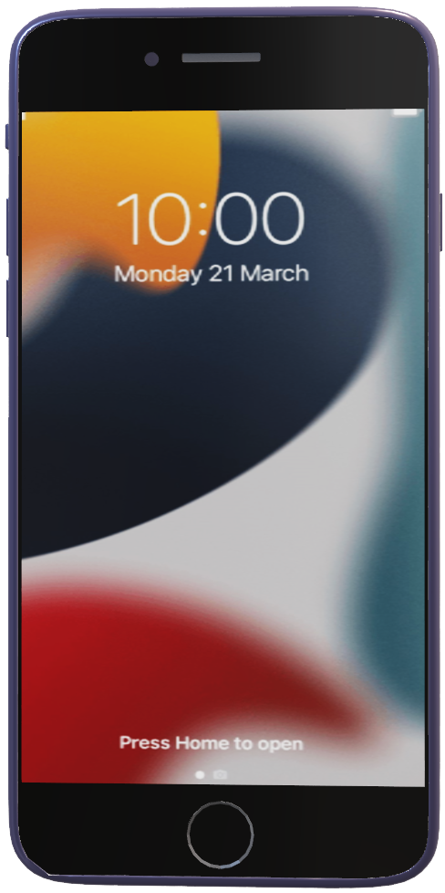



Slide 16
Notes:
If the phone’s is off and we use the power button, it will turn on the phone

Slide 17
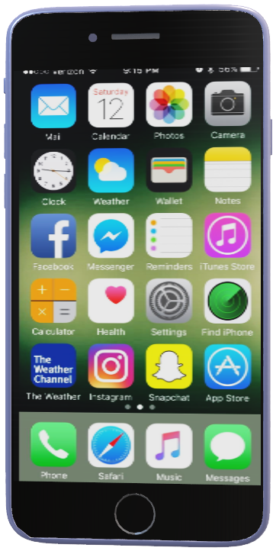
OffState
LockedState
ReadyState
Notes:
Reversely, the phone is on and we use the power button, the phone will turn off

Slide 18

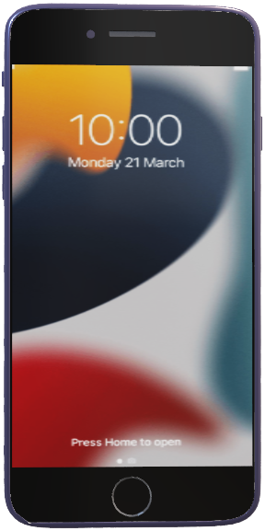
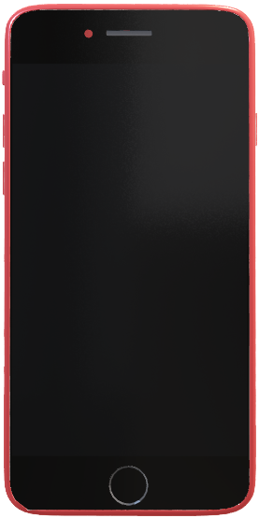
OffState
LockedState
ReadyState
Notes:
Suppose that our phone can be within 3 different states, Offstate, lockedstate and readystate.
Offstate is the initial state, the screen is black, we see nothing
Locked state, at this state the phone is turn on, but we still cant access our applications and functionalities.
Readystate, the phone is no longer being locked and we can use our phone

Slide 19





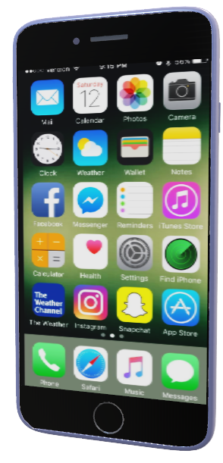

Use the Home or Power button
OffState
LockedState
Use the Power button
Use the Power button
Use the Home button
ReadyState
What is the object that changes state?
Notes:
the OffState is the initial state, in this state our phone is turn off so to turn it on we can use both the power button or Home button
to access to all the applications , we need to click a second time on the home button.
We cant use the power button this time bc it will take us back to the OffState
And finally while using our phone we can at any time use the home button to access the home page or use the power button to turn it off again.

Slide 20
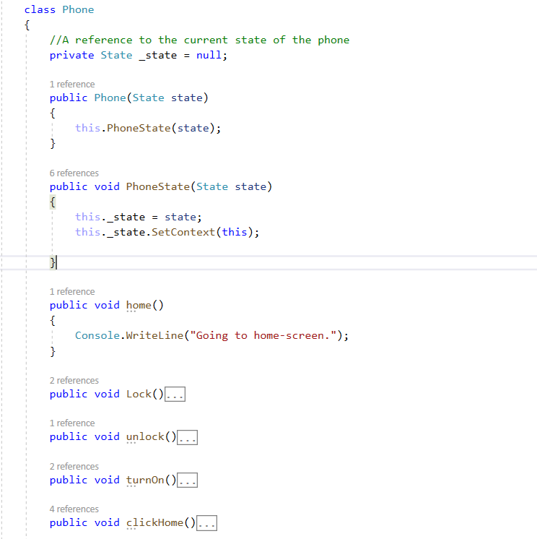






Use the Home or Power button
OffState
LockedState
Use the Power button
Use the Power button
Use the Home button
ReadyState
What is the object that changes state?

Slide 21
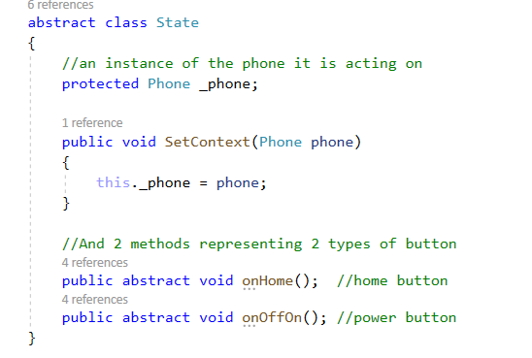

What is the object that changes state?

Slide 22
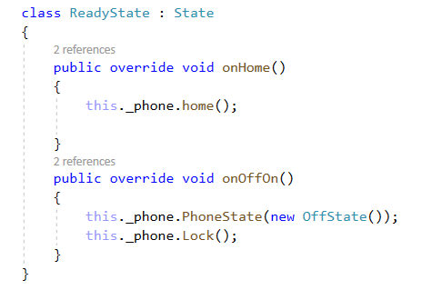
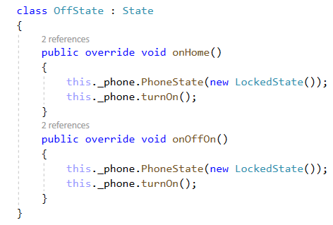
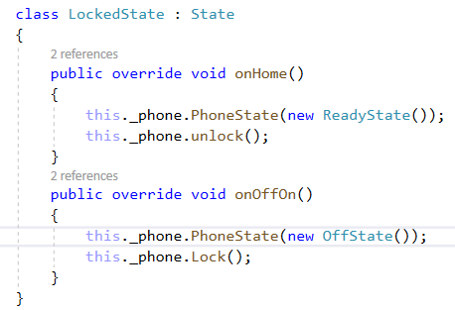

What is the object that changes state?

Slide 23
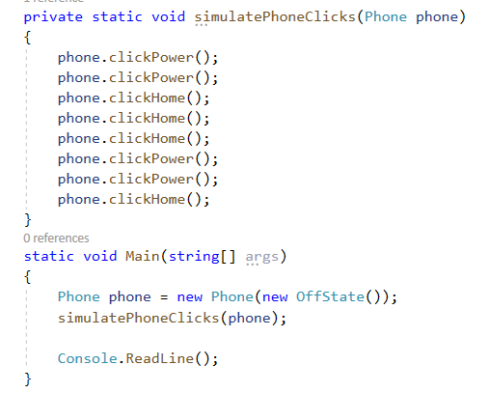
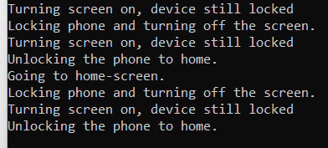

Slide 24
 | Task | Hours Budgeted | Actuals Hours
Đào Minh Đức |  | 10
Nguyễn Bảo Ngọc | Source code (State) Powerpoint (State) Trả lời câu hỏi yêu cầu? (State) | 10 | 15
Lưu Hoàng Thúy Vân | UML diagram (State) Trả lời câu hỏi? (State) | 10
Lê Nguyễn Hoàng Nghi |  | 10

